Slide 1
Capstone Project
Car Sales
Presented by : Batch-1
Maddireddy Sirisha –
Chimakurthi Radha Bhavya Sri –
Charan Kumar C N –
Rajaboina Madhuri –
Udaya Kumar R –
Nivetha R –
Bandaru Pallavi –
Yogalakshmi Tamilselvan –
Gunturi Raja Subash Chendra –
Sandeep Kumar Sivakumar –
Shaik Sharmila –
Karthick S –
Theeguri Sindhuja –

Slide 2
INDEX
Introduction
Technologies
Project Flow
Advantages
Disadvantages
Output

Slide 3
Introduction
E-Commerce website is online portals that facilitate online transactions of goods and services through means of the transfer of information and funds over the Internet. In the early days, e-commerce was done partially through emails and phone calls.
Now, with a single website, anything and everything that a transaction needs, can be executed online.

Slide 4
Technologies
HTML - 5
CSS - 3
JavaScript
MySQL - 18.21
Spring Boot
Spring MVC

Slide 5
Project Flow
Register
Login
Home
Booking
Cart
Coupon
Payment

Slide 6
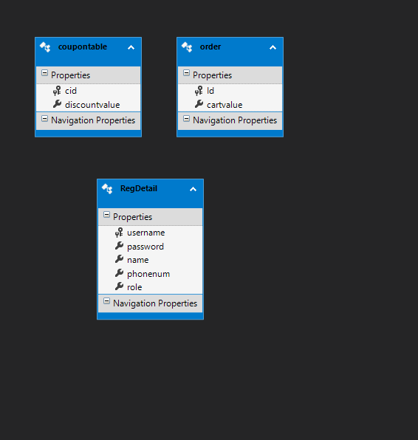
SQL Output:
Registration Table :

Slide 7
Advantages
Faster buying process
Store and product listing creation
Cost reduction
Flexibility for customers

Slide 8
Disadvantages
No One Can Buy During a Site Crash
E-commerce Is Highly Competitive
Customers Can Be Impatient
Shipping Times Can Be Lengthy

Slide 9
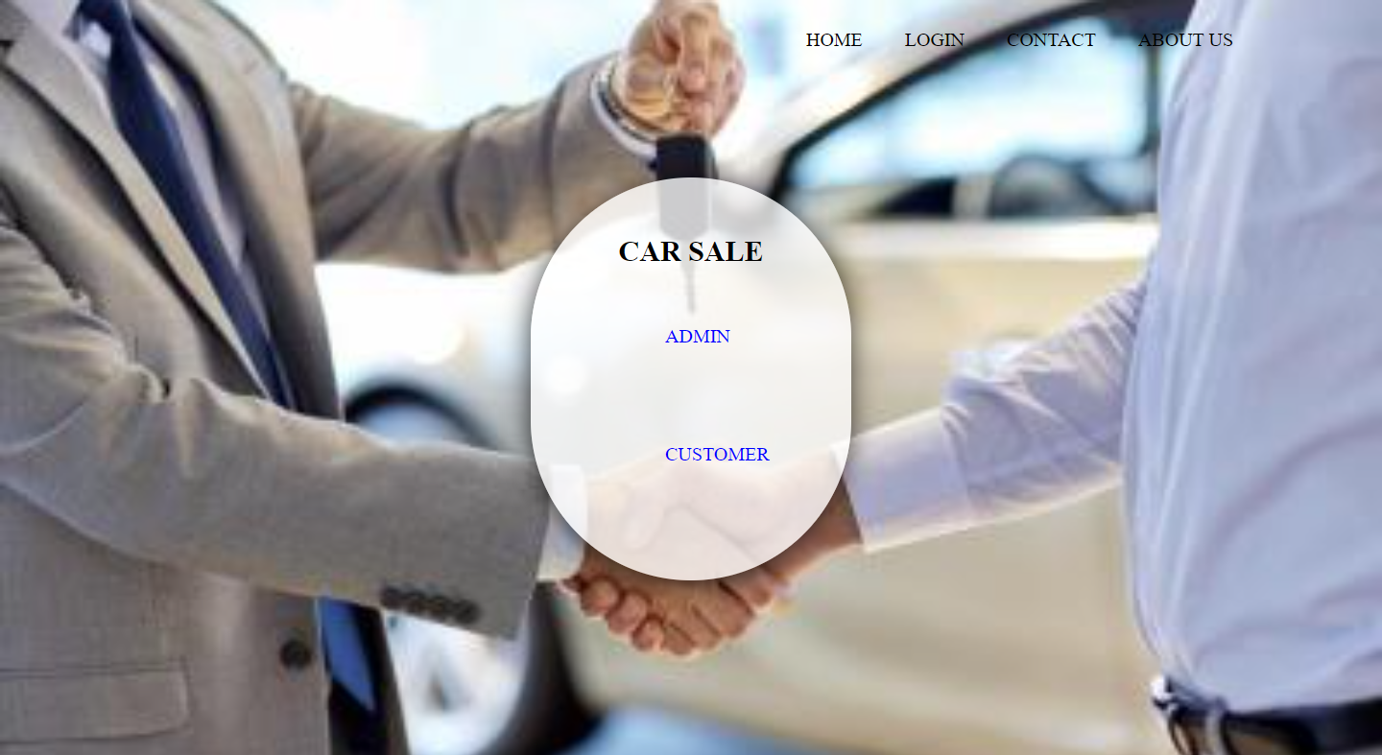
Output:

Slide 10
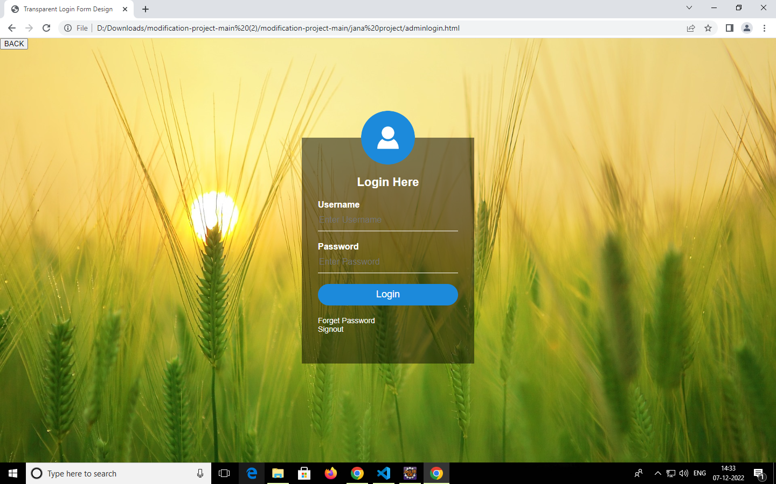
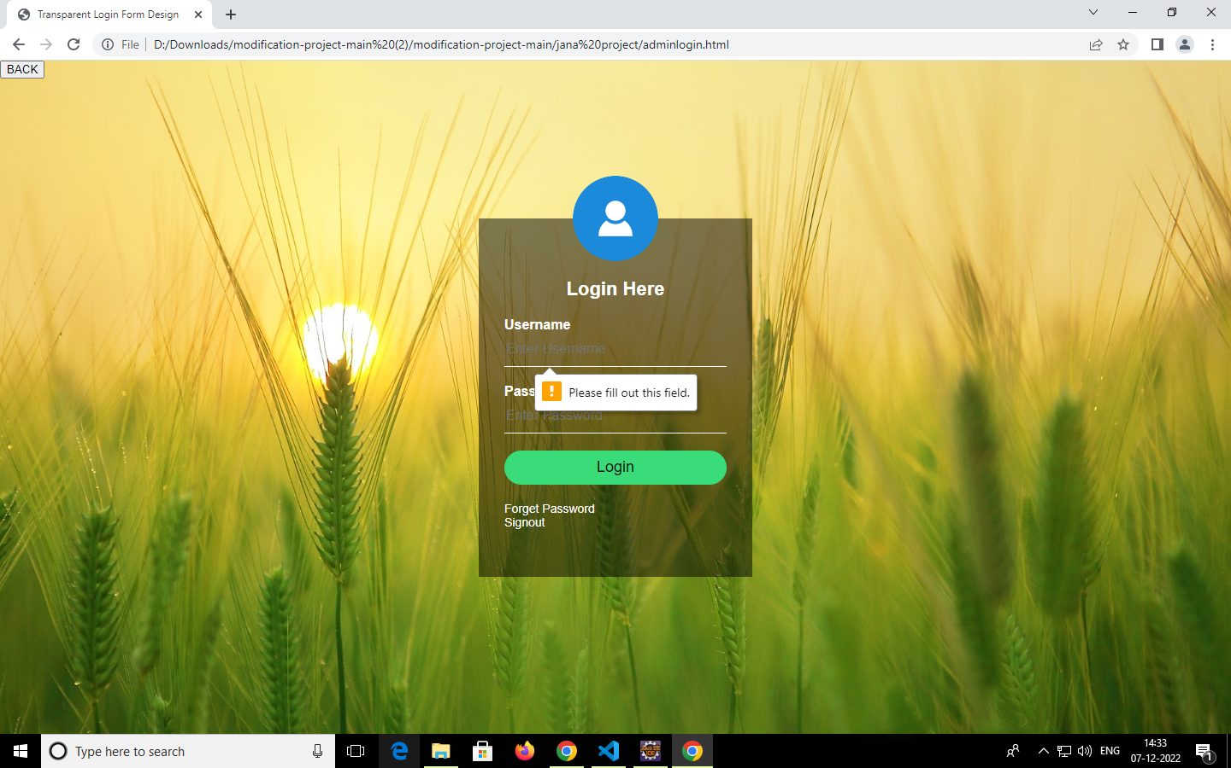
Output :

Slide 11
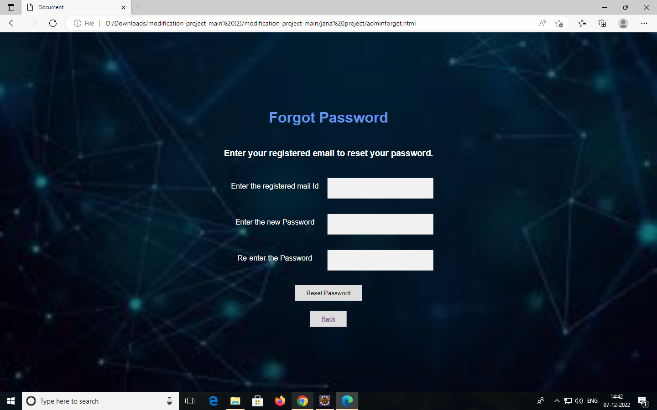
Output:

Slide 12
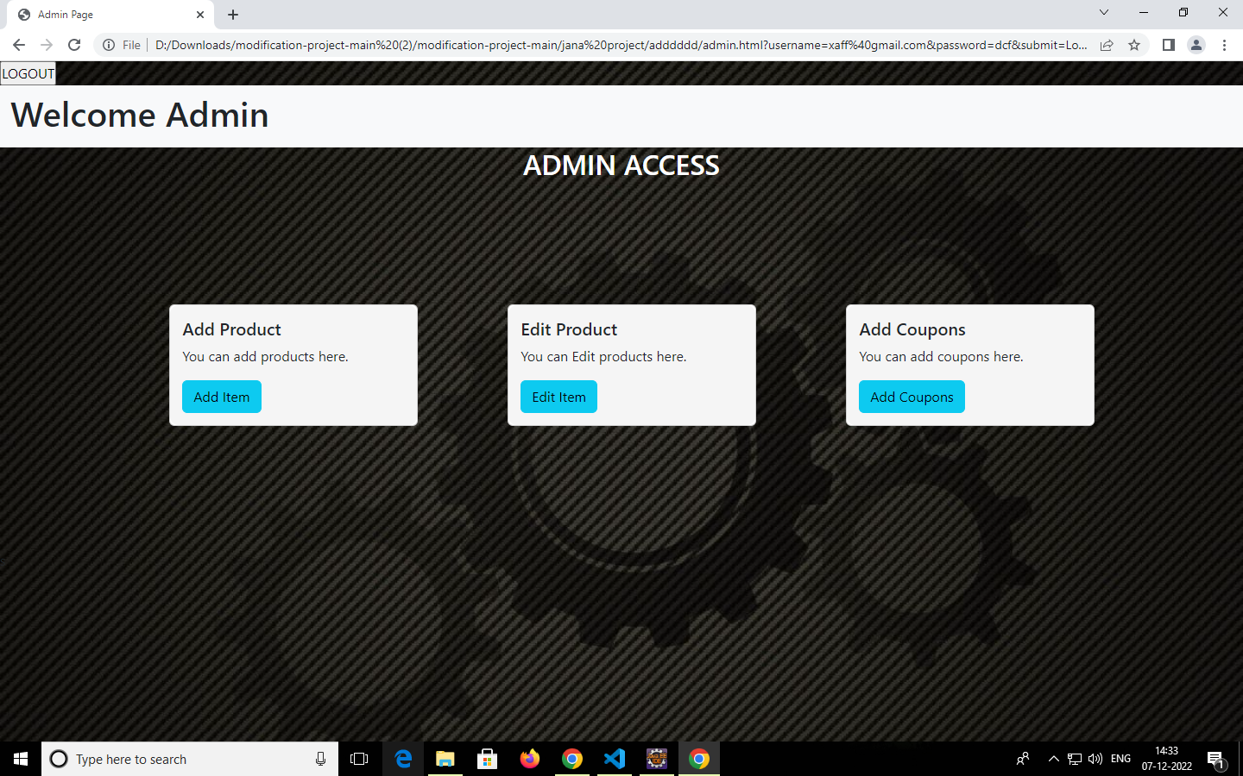
Output:

Slide 13
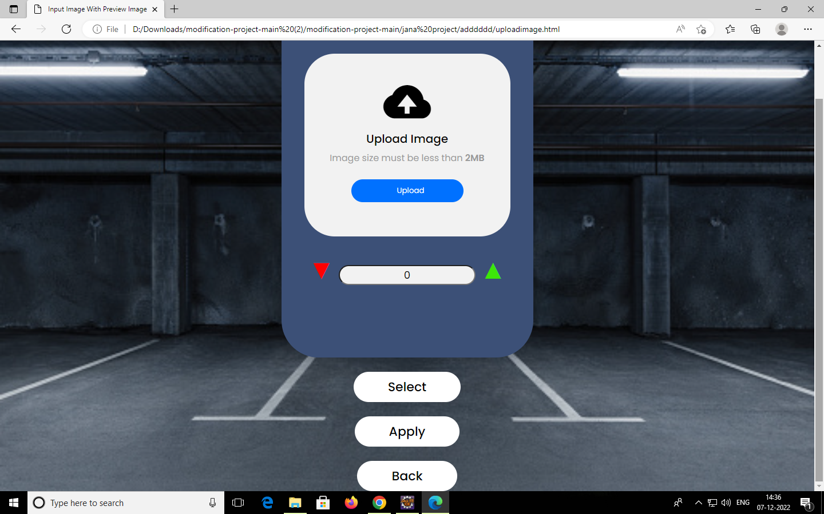
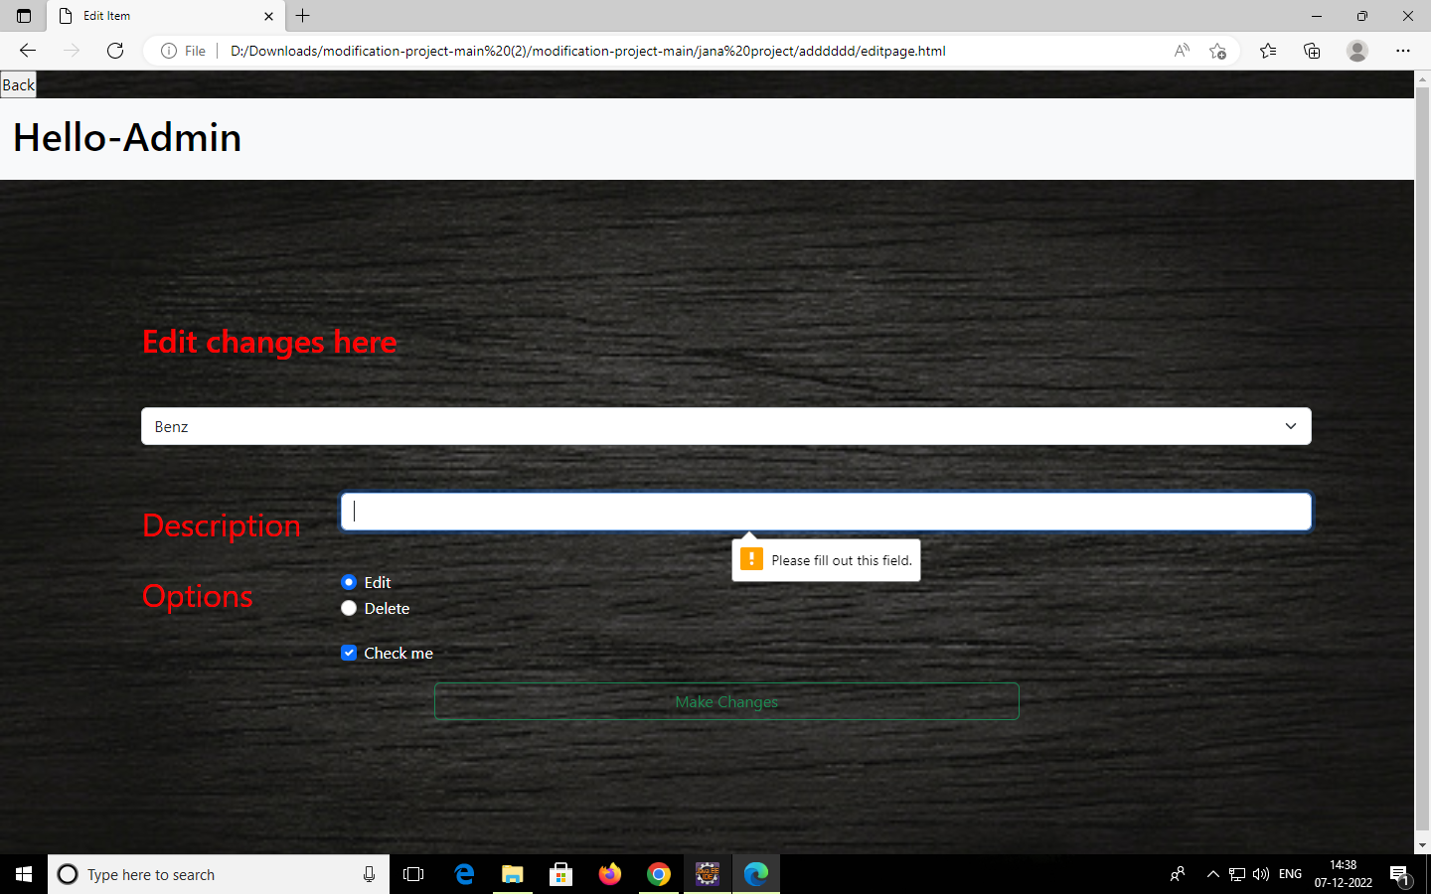
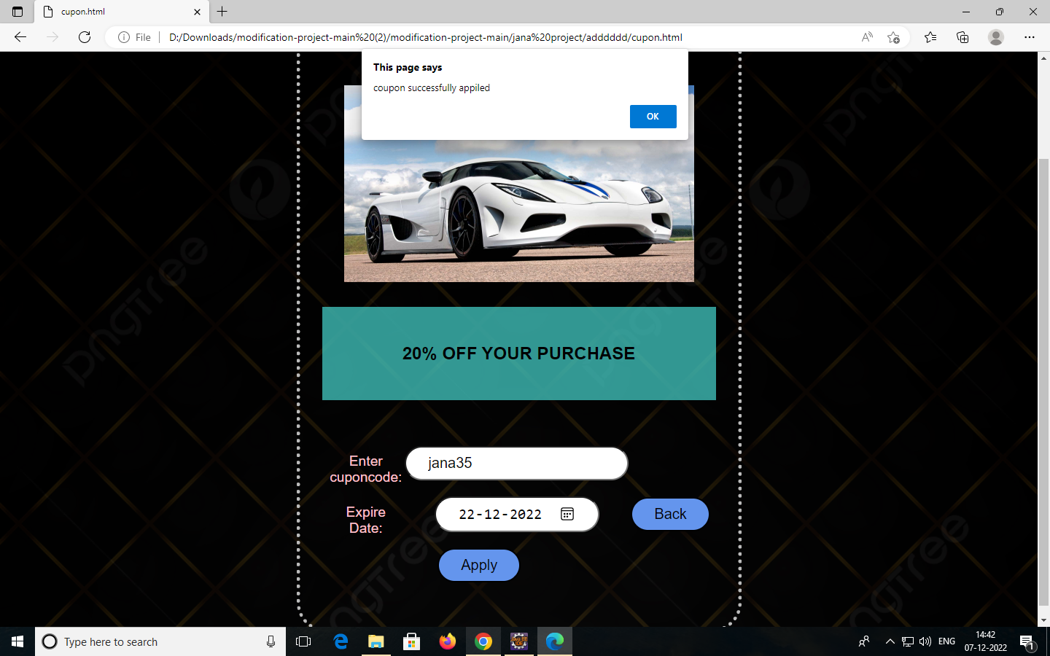
Output:

Slide 14
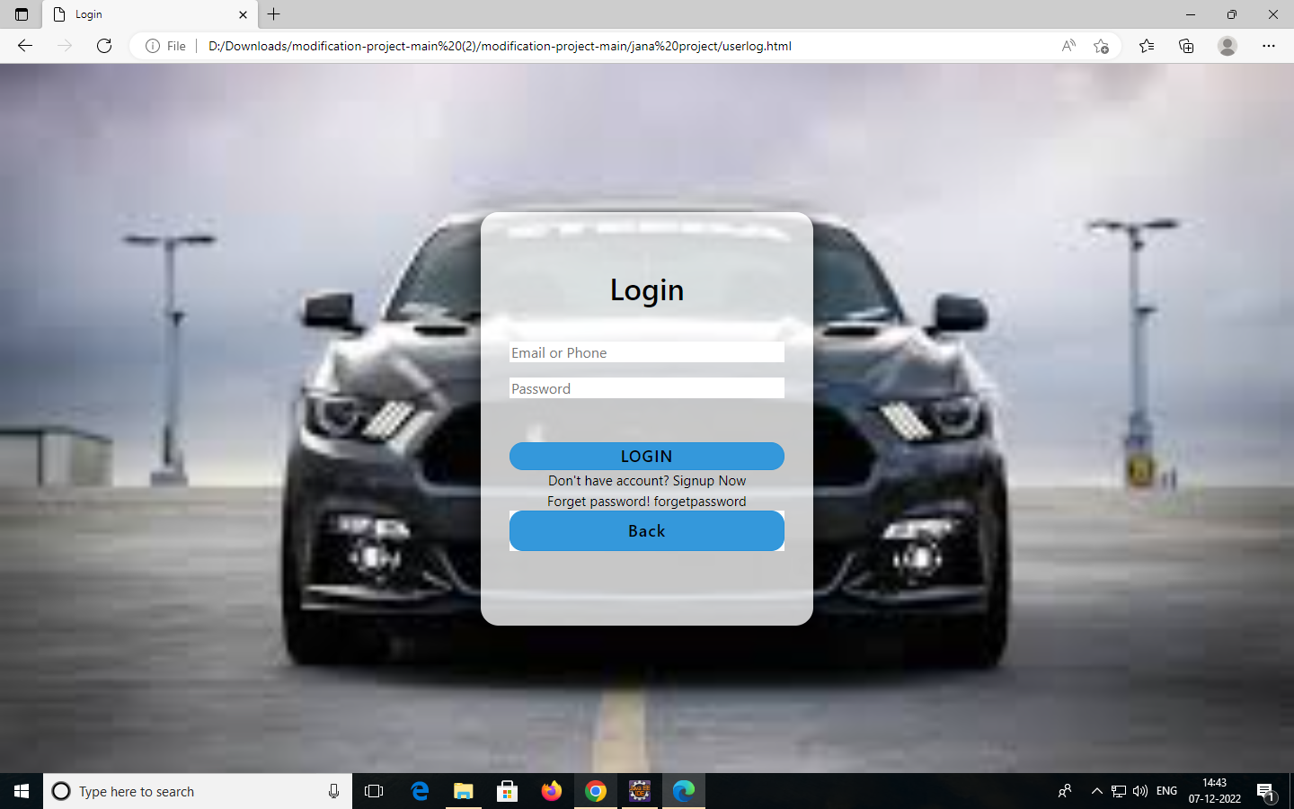
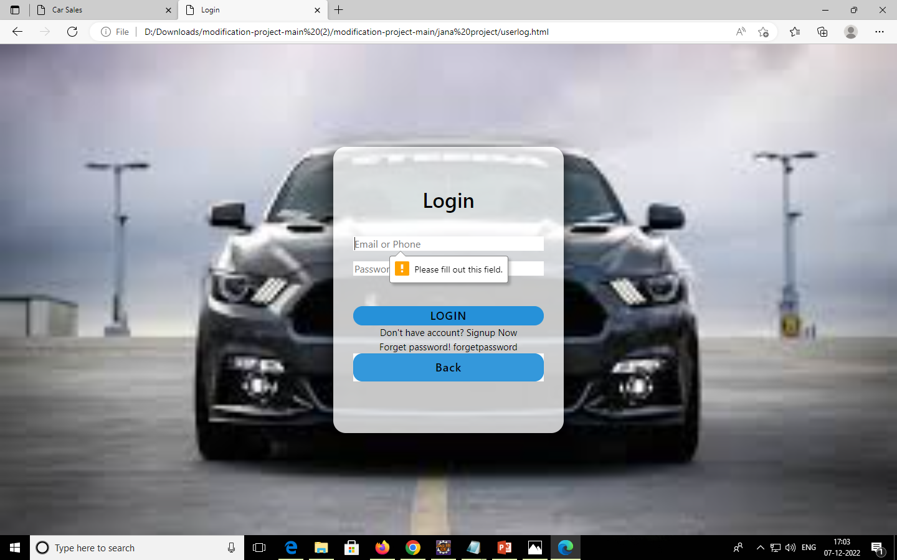
Output:

Slide 15
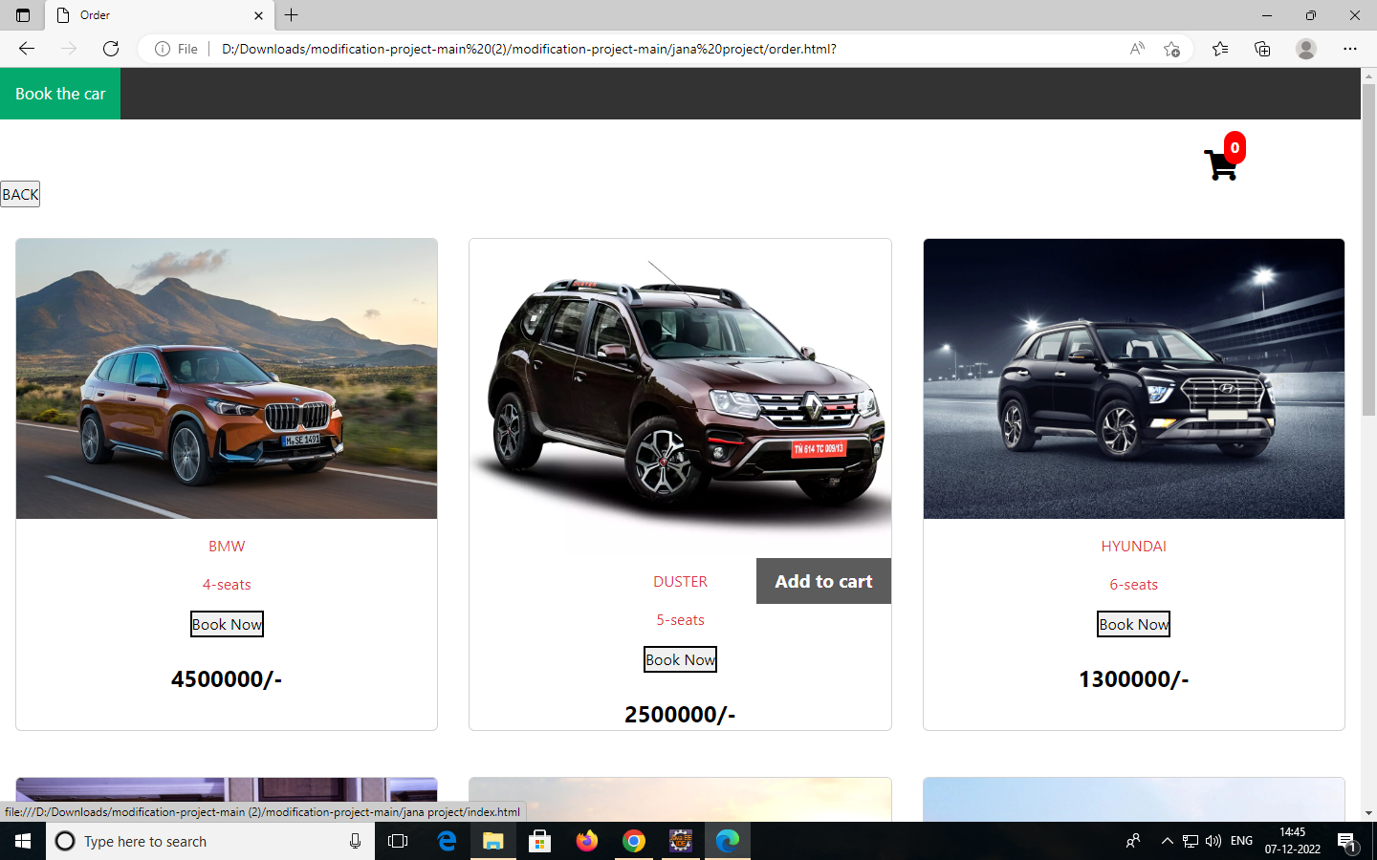
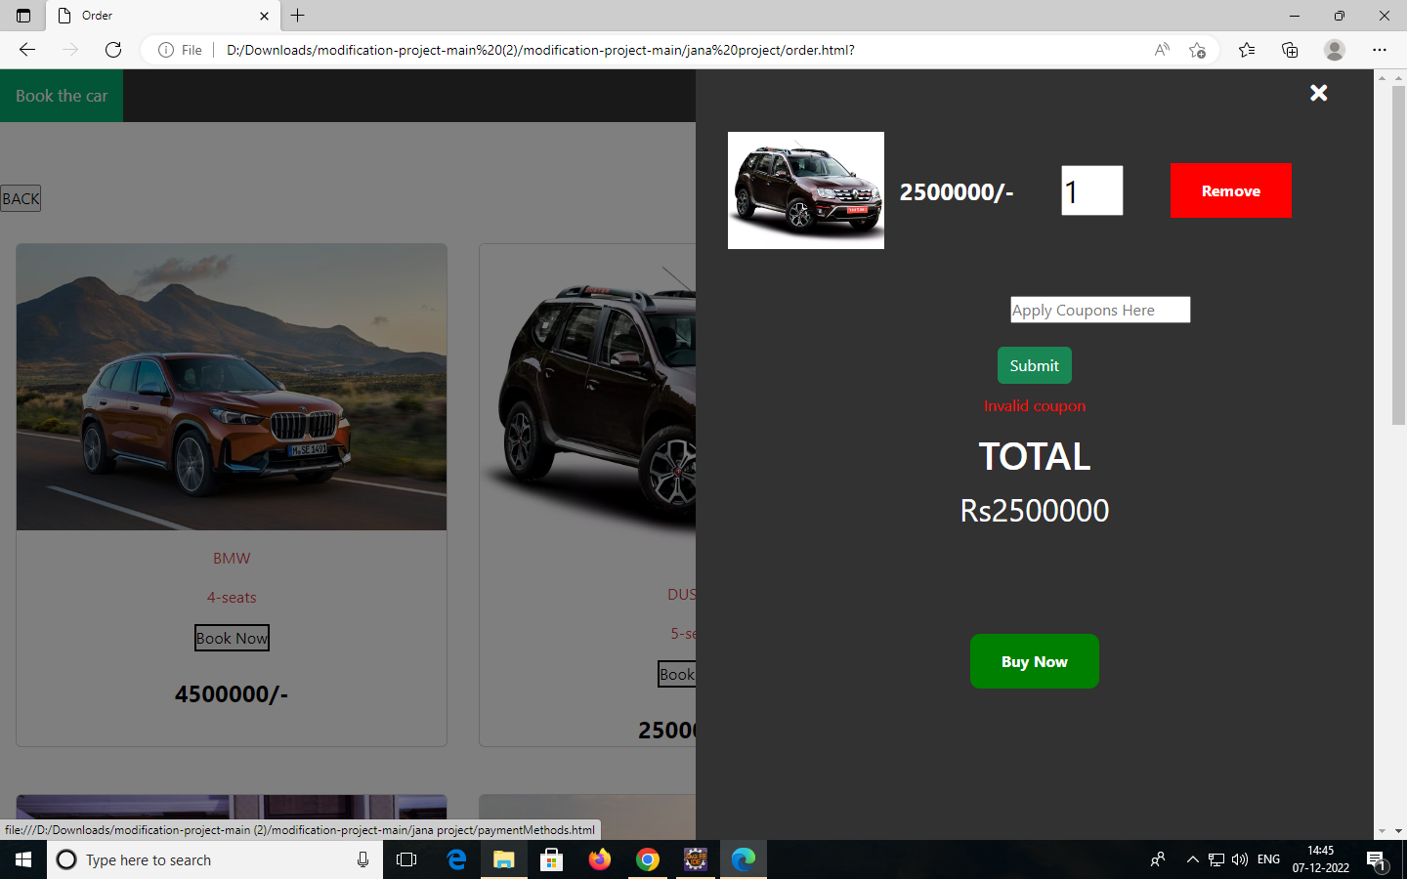
Output:

Slide 16
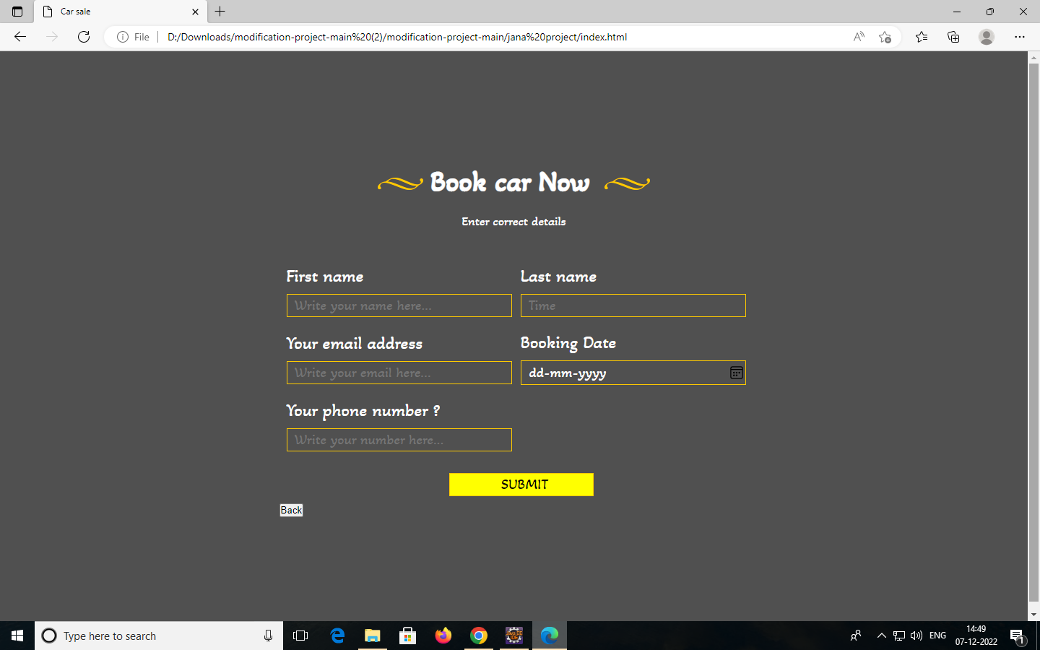
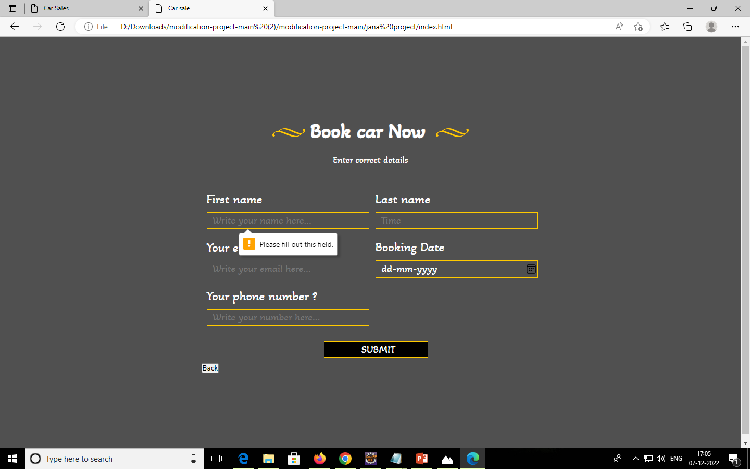
Output:

Slide 17
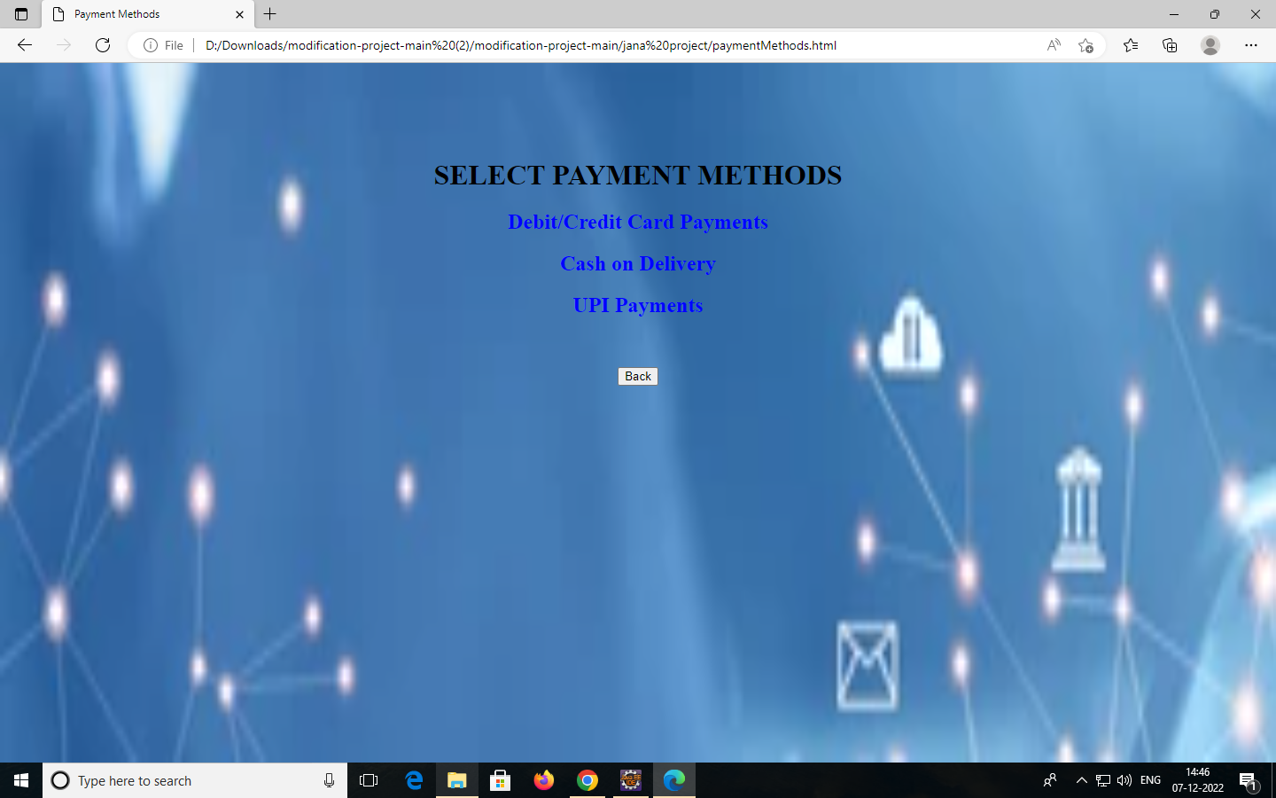
Output:

Slide 18
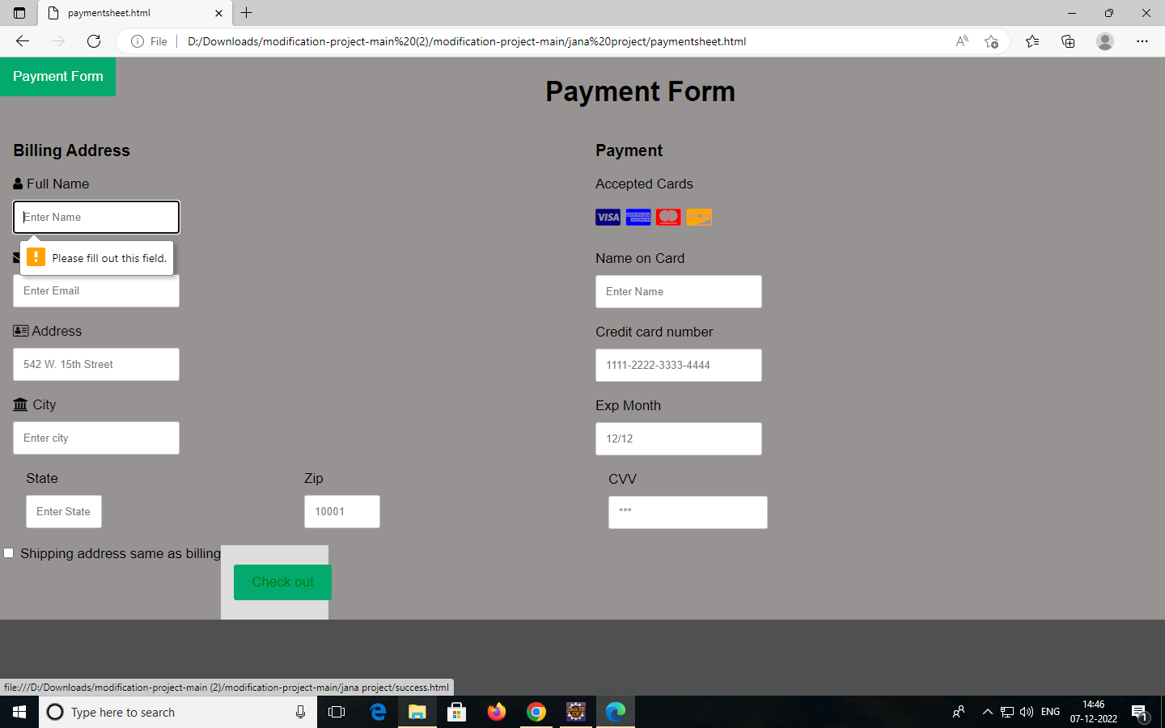
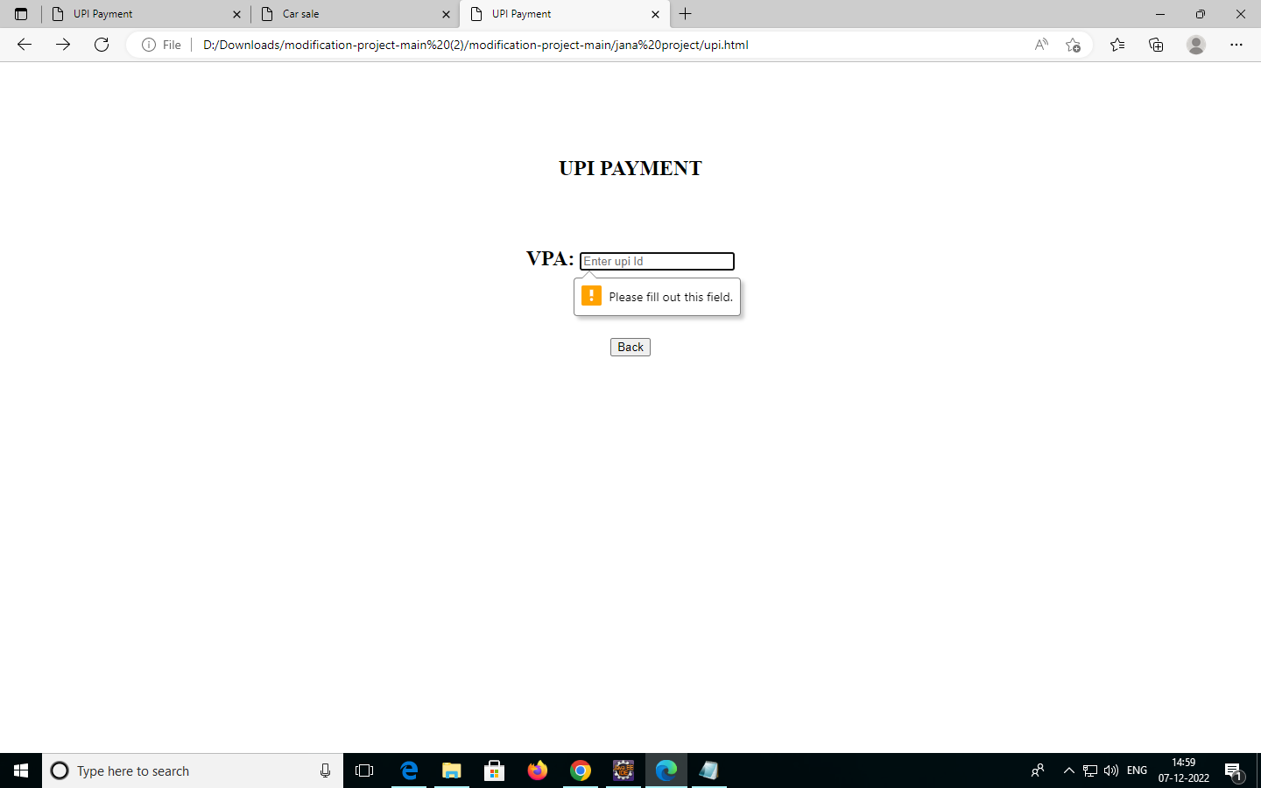
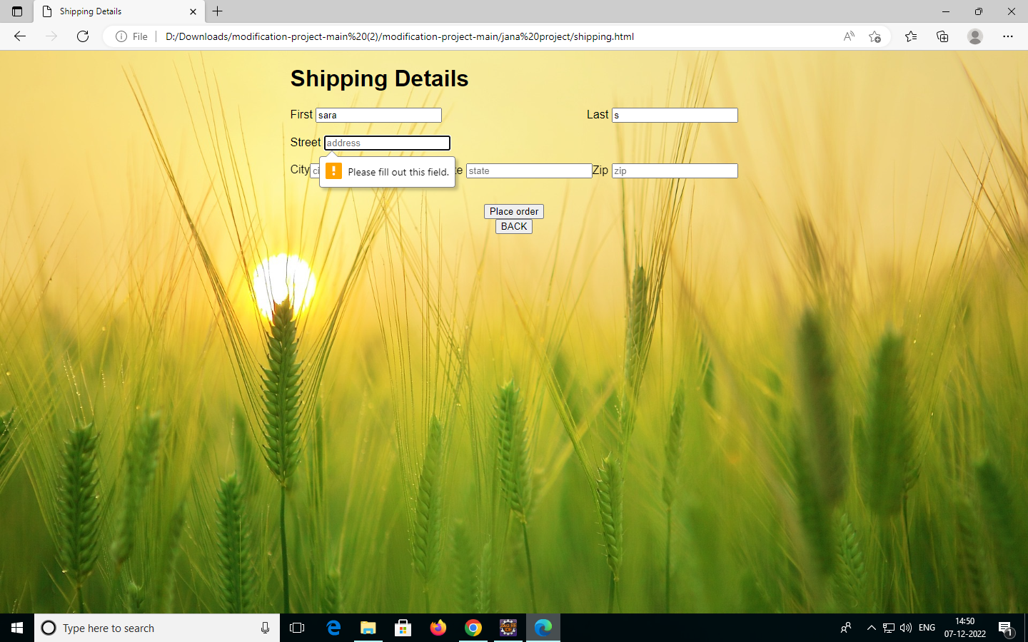
Output:

Slide 19
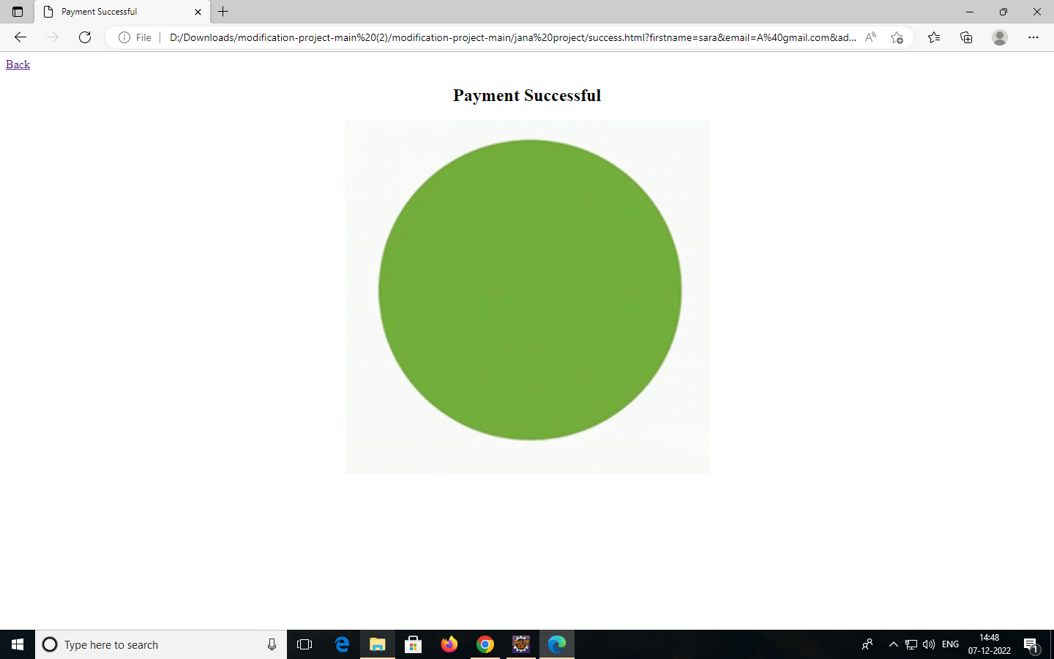
Output

Slide 20
ThankYou

